Slide 1
概率图模型
苏松志
ssz@xmu.edu.cn

Slide 2
厦门大学-机器学习-课程内容
第一讲：机器学习基础
第二讲：线性分类器：感知机+SVM+LR
第三讲：集成学习：决策树+随机森林+AdaBoost
第四讲：产生式模型：NaiveBayes, HMM
第五讲：贝叶斯学习, EM
第六讲：概率图模型
第七讲：深度学习
第八讲：动态系统

Slide 3



2011 A.M Turing Award
Judea Pearl
For fundamental contributions to artificial intelligence through the development of a calculus for probabilistic and causal reasoning.

Slide 4
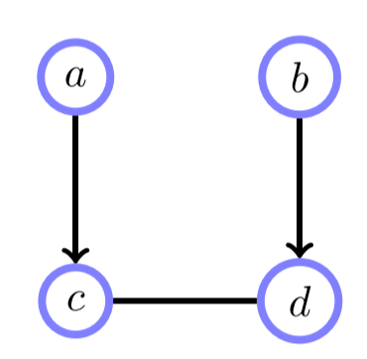
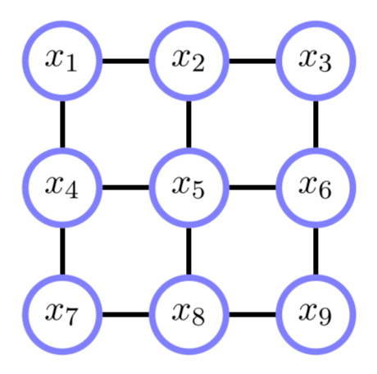
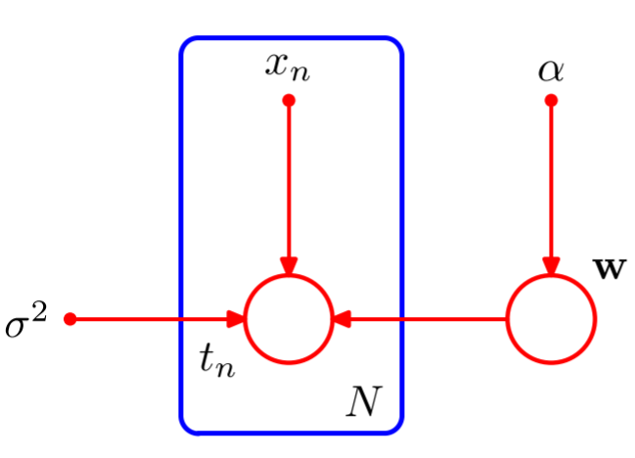
Part – 1: Basics (Model/Representation)
1.1 Definitions
1.2 Directed Graph
1.3 Undirected Graph
*1.4 Moral Graph
*1.5 Guassian Graph
*1.6 Chain Graph
Notes:
因子图和Junction Tree都是数据结构，用来作为推理的辅助，放在推理部分讲解。
在第一部分的基础知识里面，可以提一下高斯图。高斯分布和有向图和无向图都可以结合。
本讲的主要内容来自
https://www.mpi-inf.mpg.de/departments/computer-vision-and-multimodal-computing/teaching/courses/ws-20172018-probabilistic-graphical-models-and-their-applications/

Slide 5
Part 2: Inference
2.1 Exact Inference
2.1.1 Factor Graph
2.1.2 Sum-Product
2.1.3 Max-Product
2.1.4 Junction-Tree
2.2 Approximate Inference
2.2.1 Sampling
2.2.2 Variational Inference

Slide 6
Part – 3: Learning
3.1 Learning of BN
3.2 Learning of LDA

Slide 7
Part 4: Applications
4.1 PGM for Computer Vision
4.2 PGM for Natural Language Processing
4.3 PGM for SLAM
Notes:
CV/NLP/SLAM

Slide 8
4.1 PGM for Computer Vision

Slide 9
4.2 PGM for Natural Language Processing

Slide 10
4.3 PGM for SLAM
重点参考《概率机器人》和《机器人感知-因子图在SLAM中的应用》

Slide 11
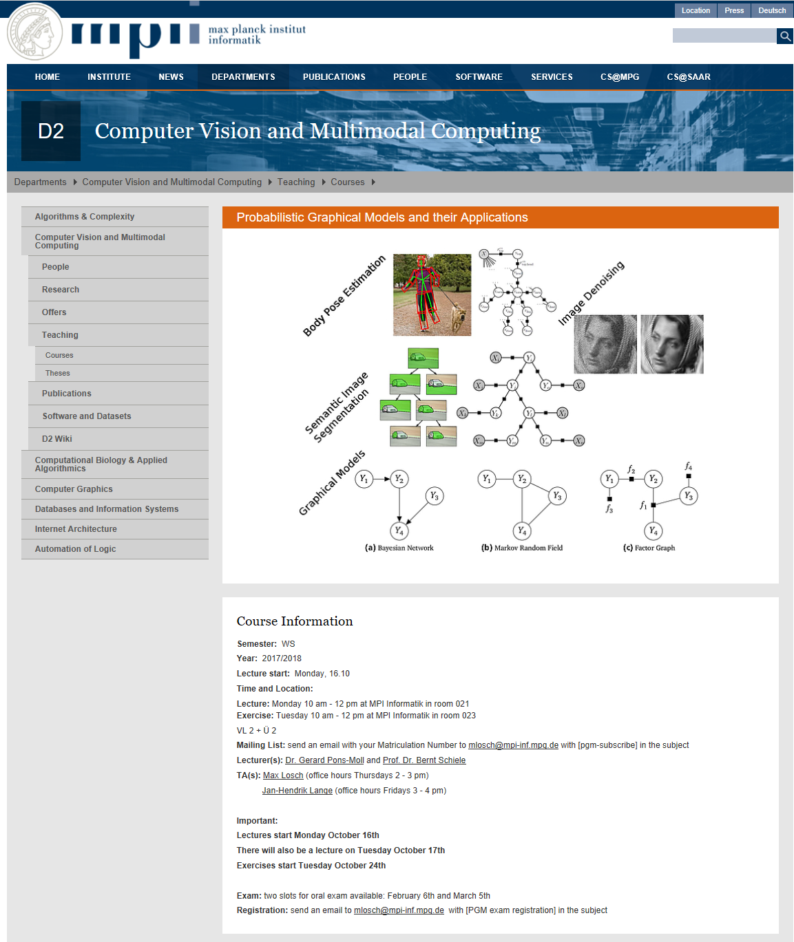
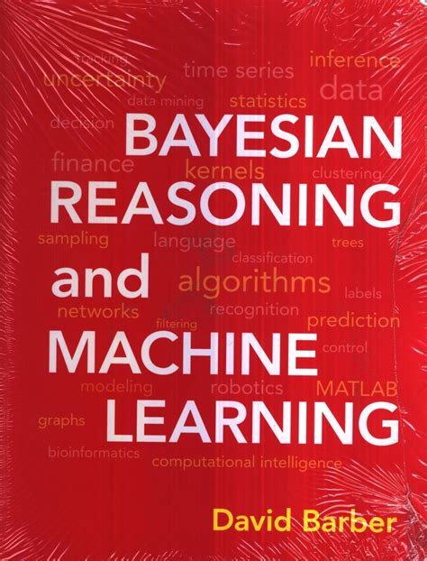
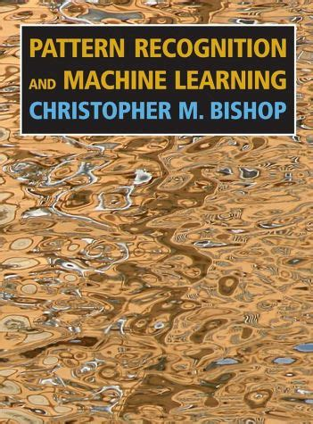

References
MPII Course
Ch1-ch6
Ch 8,9,10,11
Ch 14
Notes:
https://www.mpi-inf.mpg.de/departments/computer-vision-and-multimodal-computing/teaching/courses/ws-20172018-probabilistic-graphical-models-and-their-applications/
2018的课程很棒，作者换地方了 http://virtualhumans.mpi-inf.mpg.de/publications.html

Slide 12
Part – 1: Basics (Model/Representation)
1.1 Definitions
1.2 Directed Graph
1.3 Undirected Graph
*1.4 Chain Graph
*1.5 Guassian Graph
*1.6 Moral Graph

Slide 13
1.1 Definitions
Motivation

Slide 14
1.1 Definitions
Example - Wet
R = 1 means it has been Raining
S = 1 means Sprinkler was left on
J = 1 means Jack’s lawn is wet
T = 1 means Tracey’s lawn is wet
Notes:
这个例子作为motivation

Slide 15
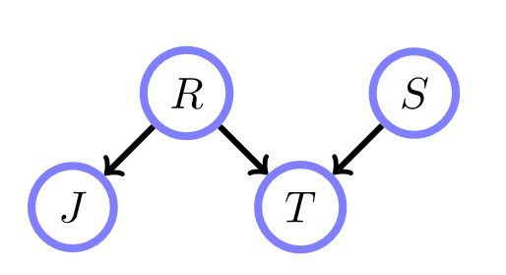
1.1 Definitions
Example - Wet: Conditional Independence
8
Notes:
带观测变量的话，则用阴影填充

Slide 16
1.1 Definitions
Example - Wet: Inference

Slide 17
1.1 Definitions
Example - Wet: Conditional Probability Table (CPT)
 | R=1
 | 0.2
 | S=1
 | 0.1
R | J = 1
0 | 0.2
1 | 1.0
R | S | T = 1
0 | 0 | 0.0
0 | 1 | 0.9
1 | 0 | 1.0
1 | 1 | 1.0

Slide 18
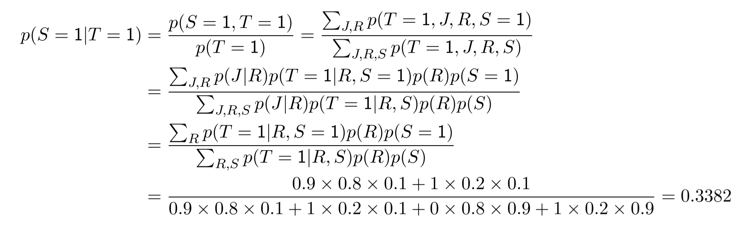
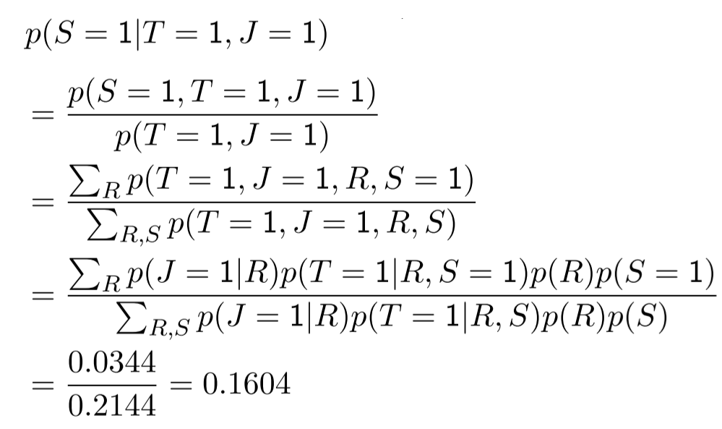
1.1 Definitions
Example - Wet: Inference
 | R=1
 | 0.2
 | S=1
 | 0.1
R | J = 1
0 | 0.2
1 | 1.0
R | S | T = 1
0 | 0 | 0.0
0 | 1 | 0.9
1 | 0 | 1.0
1 | 1 | 1.0

Slide 19
1.1 Definitions
Three Problems
Problem 1：Model
Problem 2: Inference
Problem 3: Learning
Notes:
简要描述一下这三个问题

Slide 20
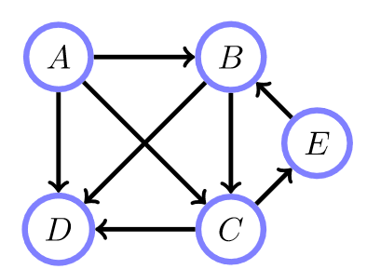
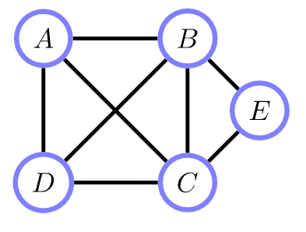
1.1 Definitions
Graph = Node + Edge
Directed Graph
Bayesian Networks
Belief Networks
Un-Directed Graph
Markov Random Field
Markov Networks
Notes:
概率和图论之间的关系
信念网络给概率模型结构信息；
概率的边缘化/条件概率等操作可以从图上之间读出来

Slide 21
1.2 Directed Graph
Examples

Slide 22
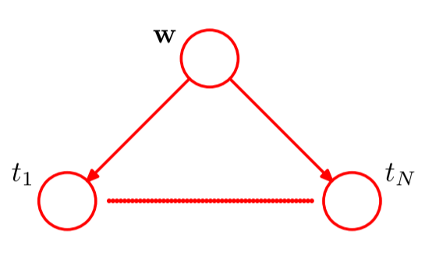
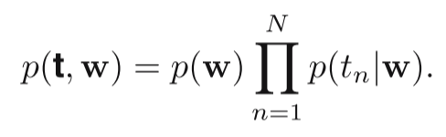
1.2 Directed Graph
a.k.a Belief Networks or Bayesian Networks (BN)
Example -1：Polynomial Regression
Notes:
修改一下，先写一个样本，再写一个数据集的，这张图需要修改

Slide 23
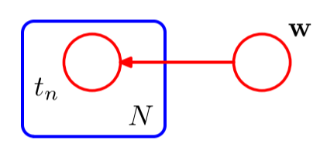
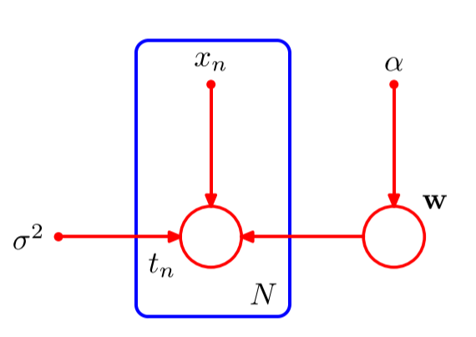
1.2 Directed Graph
Example - 1：Polynomial Regression
Notes:
数据集的表达形式，这里公式需要修改

Slide 24
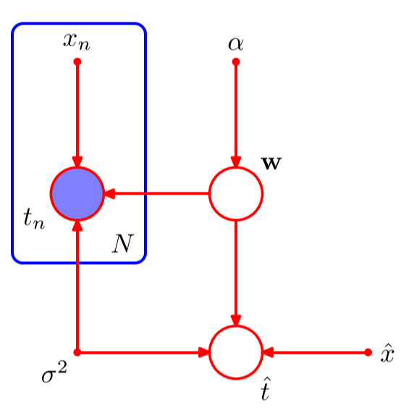
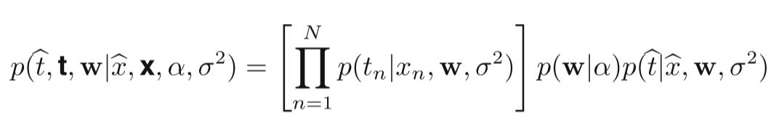
1.2 Directed Graph
Example -1：Polynomial Regression
Joint distribution
Notes:
左边手写问题的数学描述

Slide 25
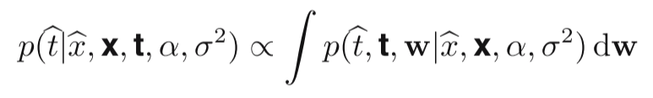
1.2 Directed Graph
Example -1：Polynomial Regression
Joint Distribution

Slide 26
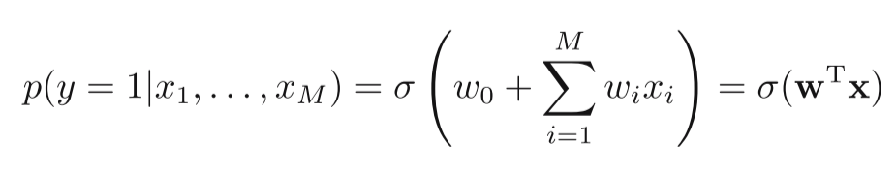
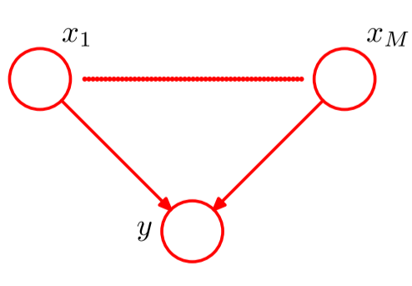
1.2 Directed Graph
Example - 2：Logistic Sigmoid Function
Notes:
注意分析，这里xi之间相互独立吗？为什么？

Slide 27
1.2 Directed Graph
Example - 3：Linear Gaussian Model
Several widely used techniques are examples of linear-Gaussian models
Probabilistic Principal Component Analysis（p-PCA）
Factor Analysis （FA）
Linear Dynamic System （LDS）
Roweis S. and Z. Ghahramani (1999) A unifying review of linear gaussian models, Neural Computation, 11(2), 305-345

Slide 28
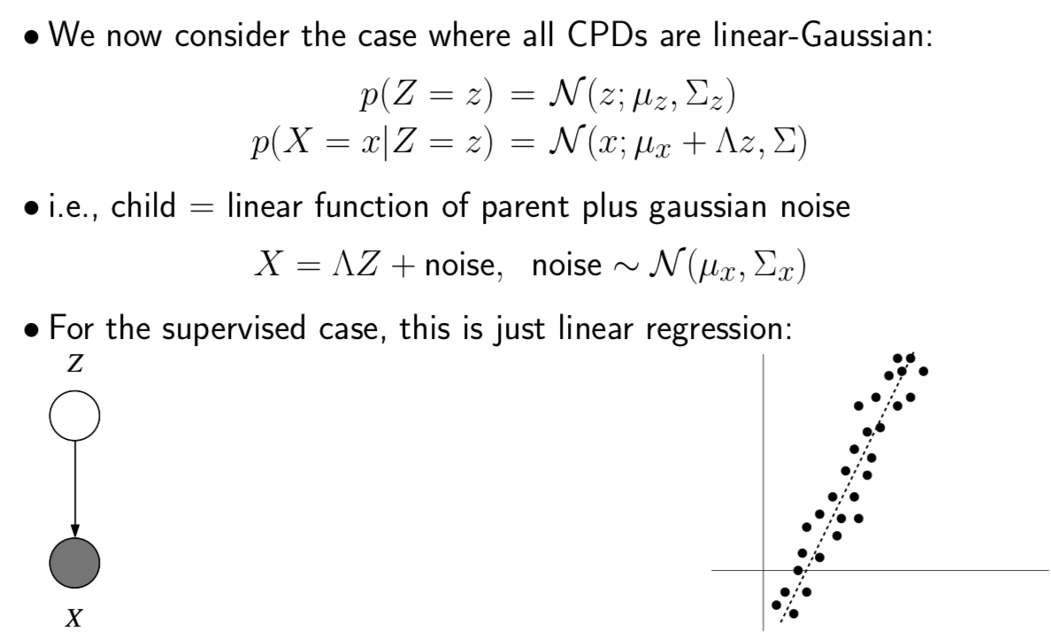
Example - 3：Linear Gaussian Model

Slide 29
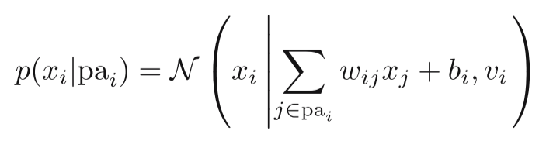
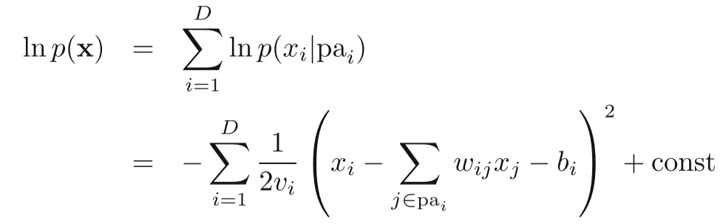
1.2 Directed Graph
Example - 4：Multivariate Gaussian Model

Slide 30
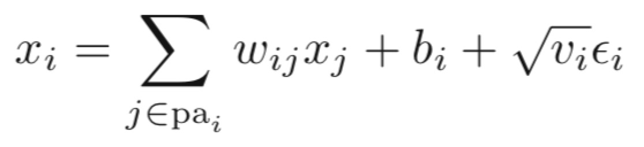
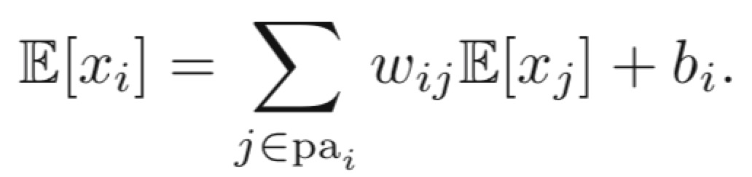
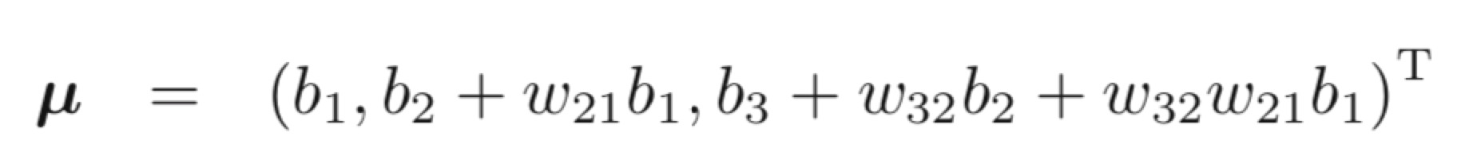
1.2 Directed Graph
Example - 4：Multivariate Gaussian Model
Expectation

Slide 31
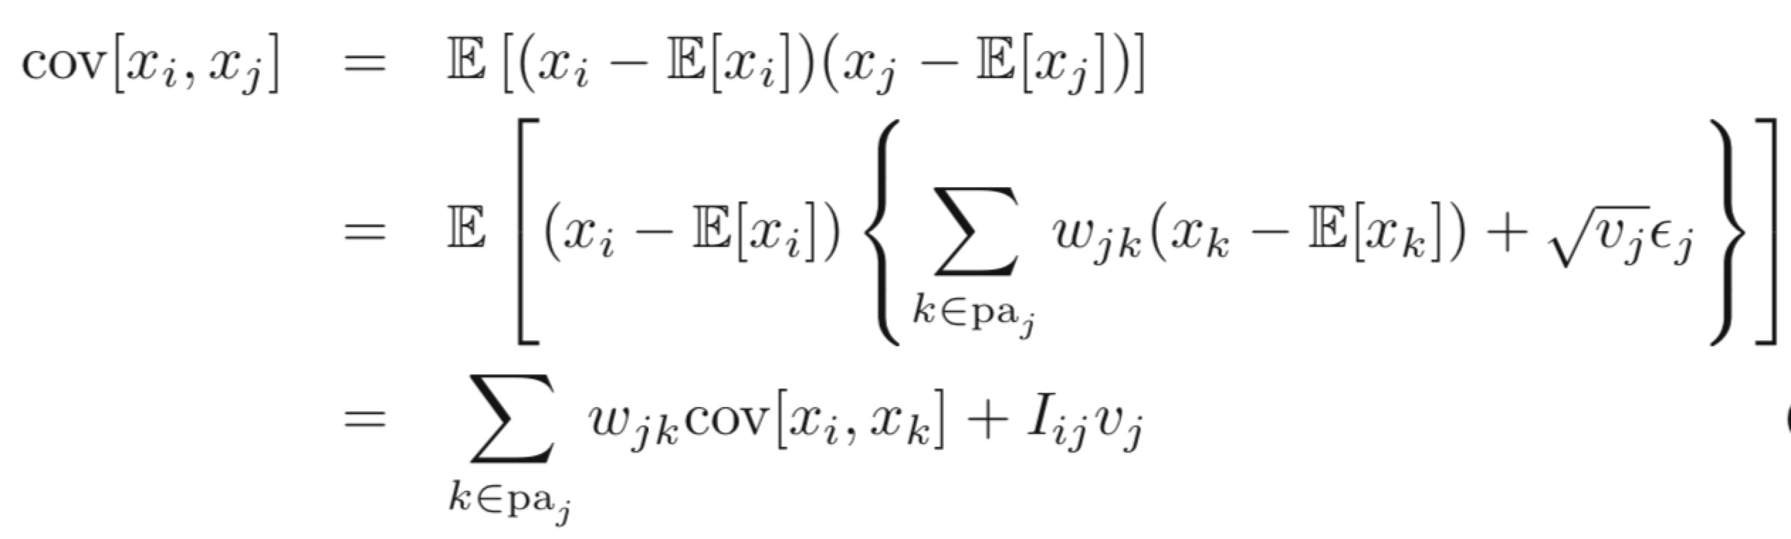
1. Basics
Example - 3：Multivariate Gaussian Model
Covariance
Notes:
Three variables with fully connected graph, write down the corresponding covariance please.

Slide 32
Example - 4：Multivariate Gaussian Model

Slide 33
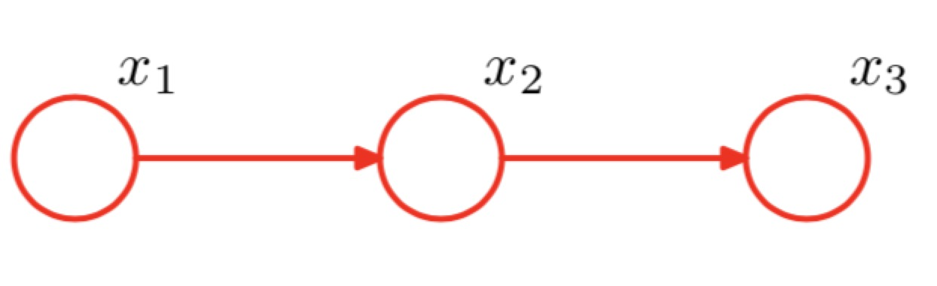
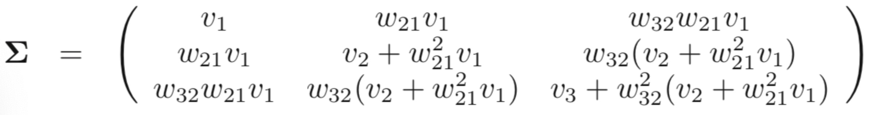
1.2 Directed Graph
Example - 4：Multivariate Gaussian Model
A directed graph over three Gaussian variables, with one missing link.
Notes:
左边手写问题的数学描述

Slide 34
Example - 4：Multivariate Gaussian Model

Slide 35
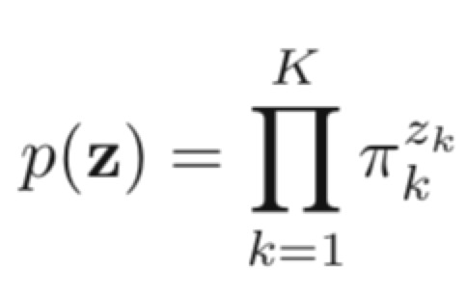
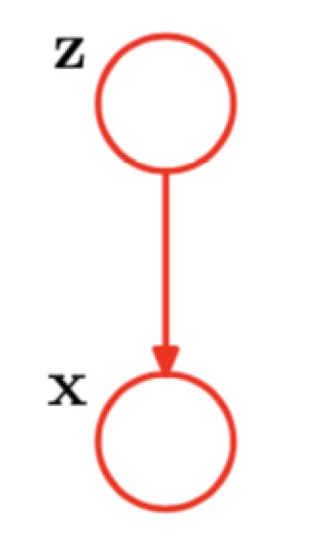
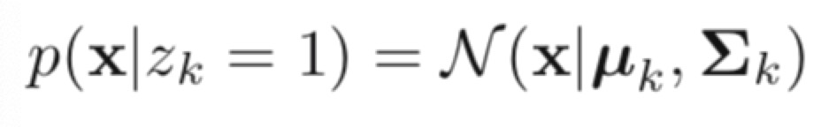
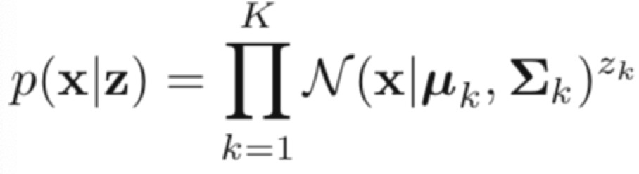
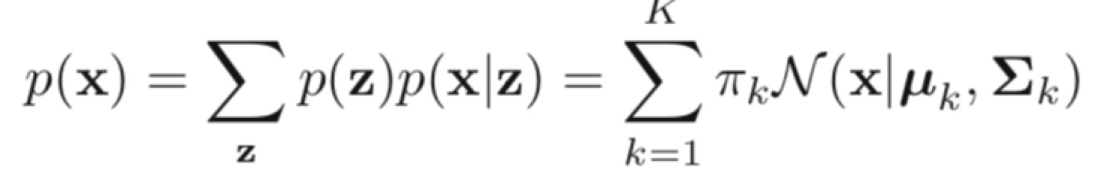
1.2 Directed Graph
Example - 5：Gaussian Mixture Model (GMM)
Notes:
左边手写问题的数学描述

Slide 36
1.2 Directed Graph
Example - 6：Hidden Markov Model (HMM)
Z₁
Z₂
……
Z_{T}
X₁
X₂
X_{T}
Notes:
左边手写问题的数学描述

Slide 37
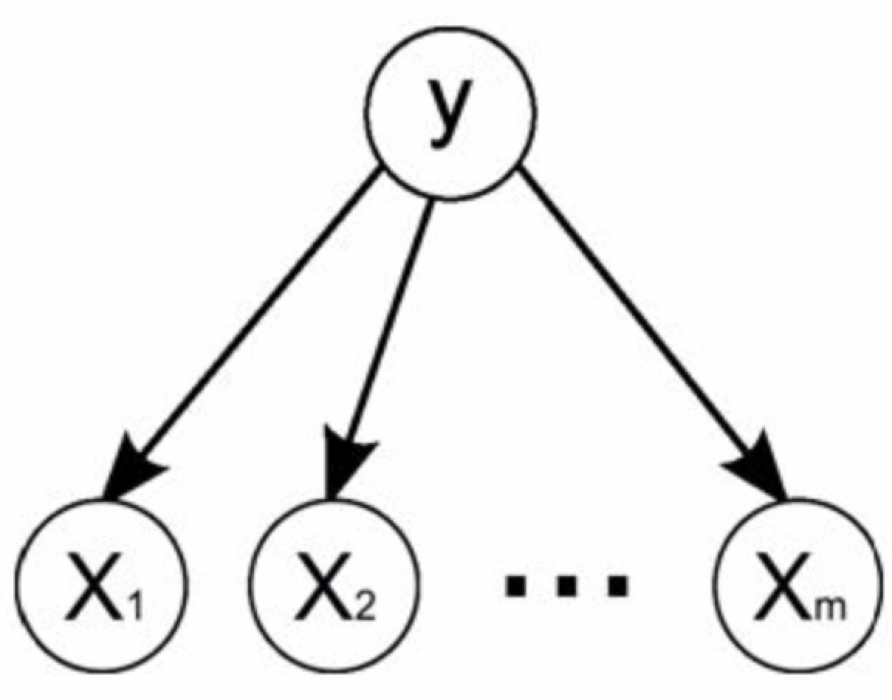
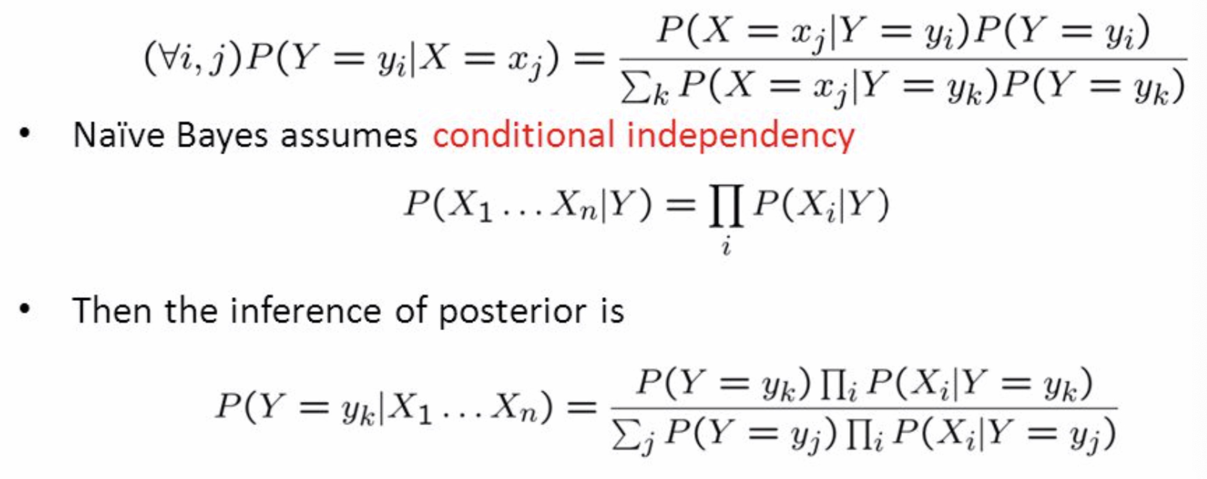
1.2 Directed Graph
Example - 7：Naïve Bayes (NB)
Notes:
左边手写问题的数学描述

Slide 38
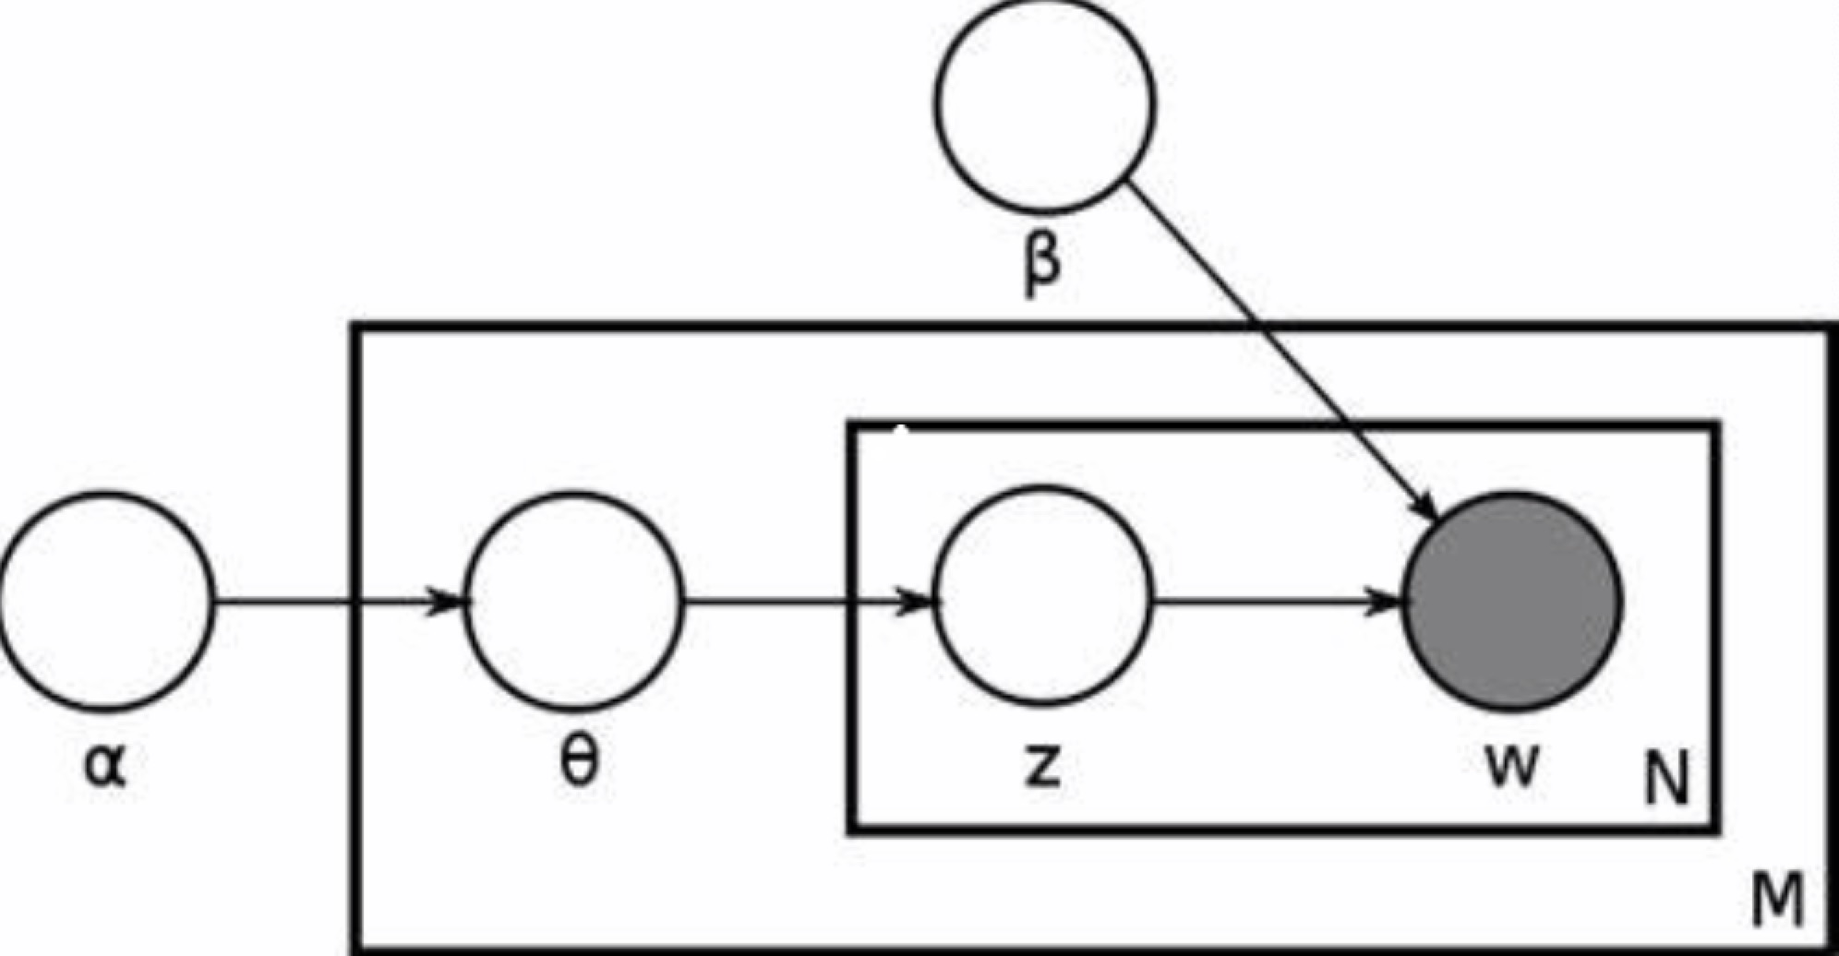
1.2 Directed Graph
Example - 8：Latent Dirichlet Allocation (LDA)
Topic Models
Notes:
左边手写问题的数学描述

Slide 39
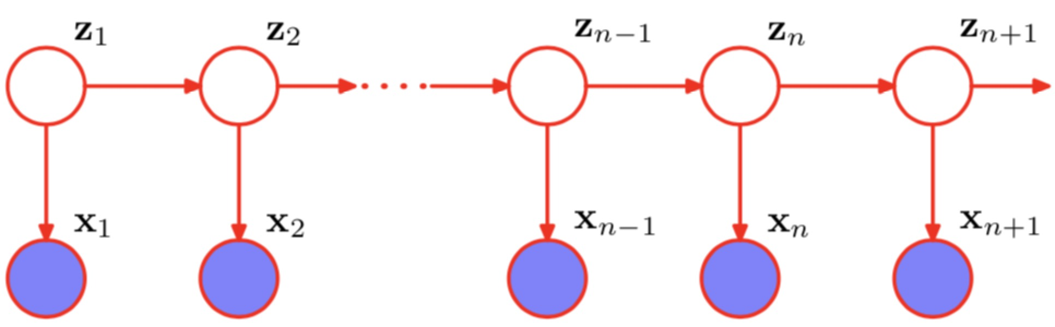
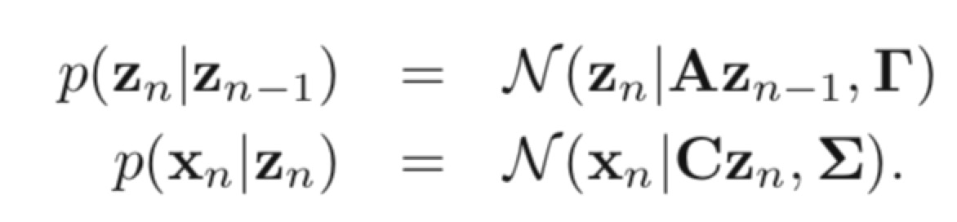
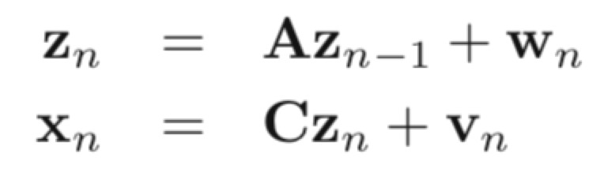
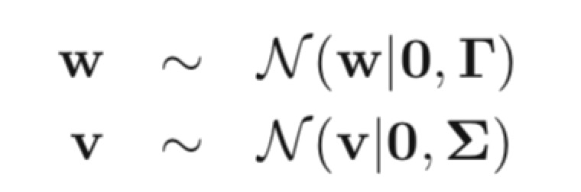
1.2 Directed Graph
Example - 9：Linear Dynamic System (LDS)
Notes:
左边手写问题的数学描述

Slide 40
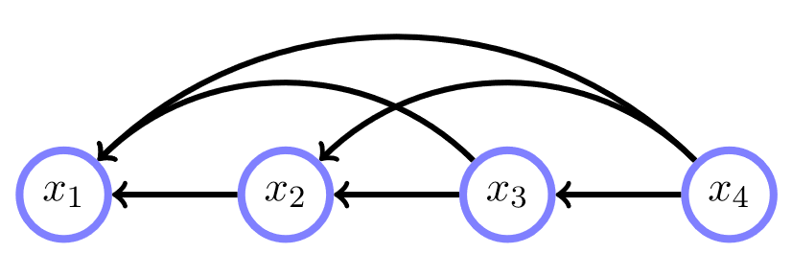
1.2 Directed Graph
Definition
A belief network is a distribution of the form
Example

Slide 41
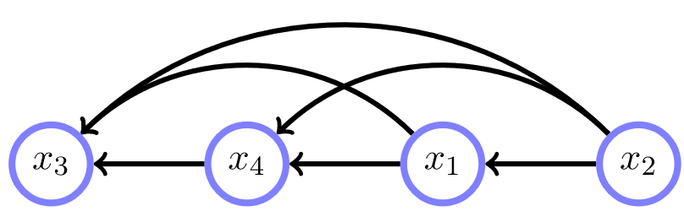
1.2 Directed Graph
Different Factorization
Notes:
手写 p(x1,x2,x3,x4) ，板书

Slide 42
1.2 Directed Graph
Structure of the DAG corresponds to a set of conditional independence assumptions
This does not mean non-parental variables have no influence
Notes:
重要！

Slide 43
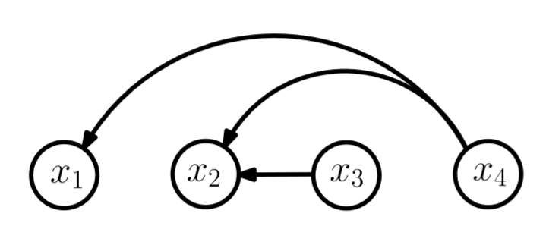
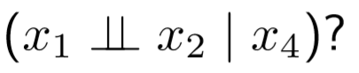
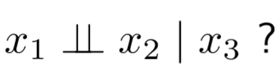
1.2 Directed Graph
Can we read C.I. directly form Graph?
Notes:
证明
P(x1,x2|x4) =…
P(x2|x4) = ….
然后就看出来了

Slide 45
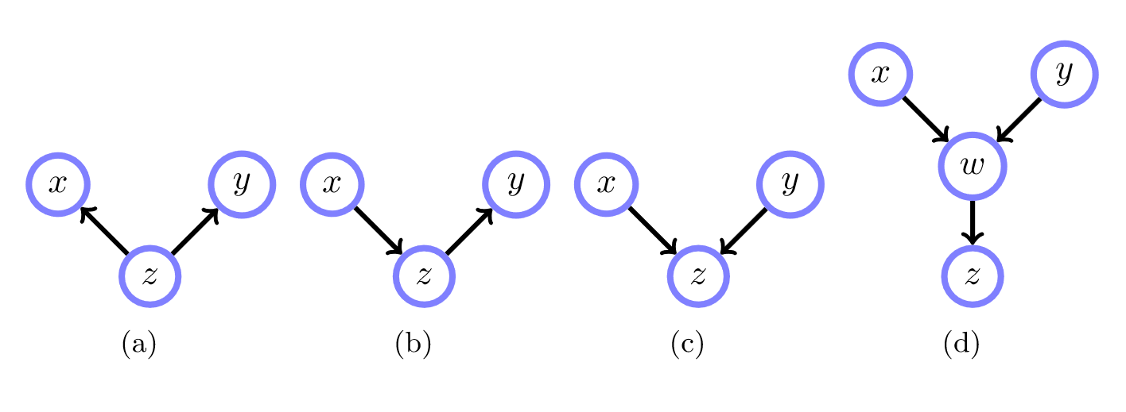
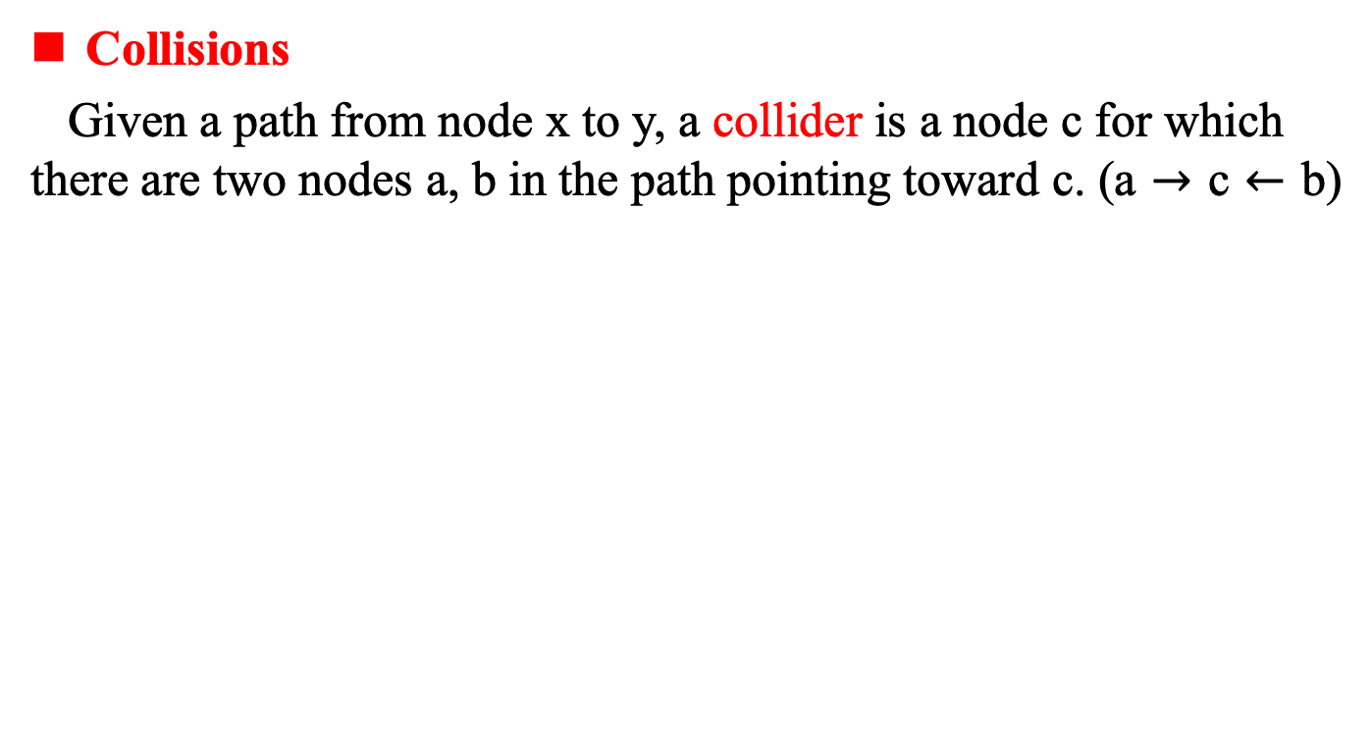
1.2 Directed Graph
Collisions
Given a path from node x to y, a collider is a node c for which there are two nodes a, b in the path pointing toward c. (a $→$ c $←$ b)
Notes:
Collider [kəˈlaɪdə(r)]

Slide 46
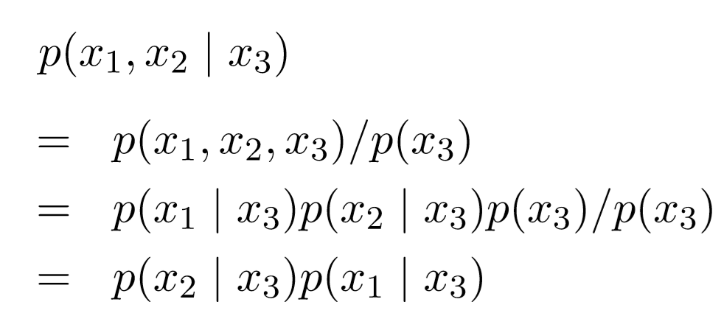
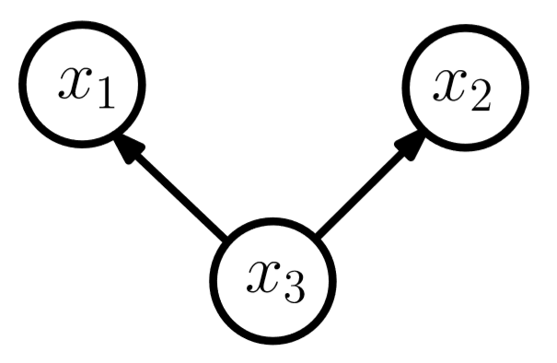

1.2 Directed Graph
Collider and Conditional Independence
Notes:
共因关系

Slide 47


1.2 Directed Graph
Collider and Conditional Independence

Slide 48




1.2 Directed Graph
Collider and Conditional Independence
Notes:
共果

Slide 49


1.2 Directed Graph
Collider and Conditional Independence

Slide 50




1.2 Directed Graph
Collider and Conditional Independence

Slide 51



1.2 Directed Graph
Graphical Manipulations to Check for Independence
Notes:
White nodes are not in the conditioning set

Slide 52


1.2 Directed Graph
Graphical Manipulations to Check for Independence
Notes:
White nodes are not in the conditioning set

Slide 53



1.2 Directed Graph
Graphical Manipulations to Check for Independence
Notes:
White nodes are not in the conditioning set

Slide 54



1.2 Directed Graph
Graphical Manipulations to Check for Independence
Notes:
White nodes are not in the conditioning set

Slide 55


1.2 Directed Graph
Graphical Manipulations to Check for Independence
Notes:
White nodes are not in the conditioning set

Slide 56




1.2 Directed Graph
Graphical Manipulations to Check for Independence
Notes:
White nodes are not in the conditioning set

Slide 57



1.2 Directed Graph
d-separation
Notes:
d= directed
条件不碰撞；碰撞不条件
喝酒不开车；开车不喝酒

Slide 58
1.2 Directed Graph
D-Seperation
Notes:
“私生”的不能被发现， omg

Slide 59


1.2 Directed Graph
Illustration of d-seperation

Slide 60



1.2 Directed Graph
Three Variable Graphs Revisited
Notes:
如何证明bcd三者是等价的
也就是说，一个pdf写出来后，有多个graph来描述他

Slide 61
1.2 Directed Graph
d-separation applications
Example – 1: MLE of Univariate Gaussian distribution

Slide 62
1.2 Directed Graph
d-separation applications
Example – 2: Naïve Bayes

Slide 63


1.2 Directed Graph
The Markov Blanket/ Markov Boundary of a node x comprises the set of parents, children and co-parents of the node.

Slide 64


1.2 Directed Graph
Filter View of a Graphical Model

Slide 65
Contents
Part – 1: Basics (Model/Representation)
1.1 Definitions
1.2 Directed Graph
1.3 Undirected Graph
*1.4 Moral Graph
*1.5 Guassian Graph
*1.6 Chain Graph
Notes:
因子图和Junction Tree都是数据结构，用来作为推理的辅助，放在推理部分讲解。
在第一部分的基础知识里面，可以提一下高斯图。高斯分布和有向图和无向图都可以结合。
本讲的主要内容来自
https://www.mpi-inf.mpg.de/departments/computer-vision-and-multimodal-computing/teaching/courses/ws-20172018-probabilistic-graphical-models-and-their-applications/
本讲的主要内容来自
https://www.mpi-inf.mpg.de/departments/computer-vision-and-multimodal-computing/teaching/courses/ws-20172018-probabilistic-graphical-models-and-their-applications/

Slide 66

1.3 Undirected Graph (Markov Networks)
1.3.1 Definitions
1.3.2 Properties
1.3.3 Hammersley-Clifford Theorem
1.3.4 Filter View

Slide 67
1.3 Undirected Graph
1.3.1 Definitions
Notes:
Belief networks correspond to a special kind of factorization of the joint probability distribution in which each of the factors is itself a distribution

Slide 68



1.3.1 Definitions
Potential
Example
Notes:
Belief networks correspond to a special kind of factorization of the joint probability distribution in which each of the factors is itself a distribution

Slide 69

1.3.1 Definitions
Markov Network
Notes:
Belief networks correspond to a special kind of factorization of the joint probability distribution in which each of the factors is itself a distribution

Slide 70





1.3.1 Definitions
Example - 1: Boltzmann Machine
Notes:
如果xi和xj的取值都为1，wij>0是的能量下降，概率变大；
链接权重表示假设之间是相互支持还是互相抵消的关系
配分函数z通常难以计算，一般通过mcmc方法近似，生成一组服从P（x）的样本

Slide 71



Example - 2: Restricted Boltzmann Machine （RBM）

Slide 72

Assignment 1
Notes:
画出boltzman机的图像表示，矩阵形式的表示方法
点出BM 与 RBM之间的关系
补充练习4.3 4.4

Slide 73


Assignment 2

Slide 74


1.3.1 Definitions
RBM vs. Deep Belief Network （DBN）

Slide 75


Example 3: Conditional Random Field (CRF)
Notes:
https://people.cs.umass.edu/~mccallum/papers/crf-tutorial.pdf
https://people.cs.umass.edu/~wallach/technical_reports/wallach04conditional.pdf
http://www.cs.columbia.edu/~mcollins/crf.pdf
http://blog.echen.me/2012/01/03/introduction-to-conditional-random-fields/

Slide 76




Example 4: Ising Models
Average alignment of the variable
Notes:
分析一下温度T对整个磁场的影响

Slide 77




Example 4: Ising Models
Ising models for Image Denoising
Notes:
如何推理，见后面分解，
如果只有两个像素呢，分析一下，推理初体验
结构化预测学习， 这个例子重点讲解一下。

Slide 78

详细解释一下去噪的原理

Slide 79
1.3 Undirected Graph (Markov Networks)
1.3.1 Definitions
1.3.2 Properties
1.3.3 Hammersley-Clifford Theorem
1.3.4 Filter View

Slide 80





1.3.2 Properties of Markov Networks

Slide 81

1.3.2 Properties of Markov Networks
Notes:
课堂上请同学们证明这个结论

Slide 82



1.3.2 Properties of Markov Networks
Property 1: Global Markov Property

Slide 83

1.3.2 Properties of Markov Networks
Separation
A subset S separates a subset A from a subset B (for disjoint A and B) if every path from any member of A to any member of B passes through S.
If there is no path from a member of A to a member of B then A is separated from B.
If S = NULL then provided no path exists from A to B, A and B are separated.
Notes:
要么无路可走，要是有路，必从S集过。

Slide 84


1.3.2 Properties of Markov Networks
Property 2: Local Markov Property
Condition on neighbours independent on rest
Example
Notes:
论邻居的重要性

Slide 85

1.3.2 Properties of Markov Networks
Property 3: Pairwise Markov Property
x
y
X \ {x , y}

Slide 86
1.3.2 Properties of Markov Networks
For positive potentials, local, pairwise and global Markov properties are all equivalent.
Local = Pairwise = Global

Slide 87
1.3 Undirected Graph (Markov Networks)
1.3.1 Definitions
1.3.2 Properties
1.3.3 Hammersley-Clifford Theorem
1.3.4 Filter View

Slide 88

1.3.3 Hammersley-Clifford Theorem

Slide 89

1.3.3 Hammersley-Clifford Theorem

Slide 90

1.3.3 Hammersley-Clifford Theorem

Slide 91

1.3.3 Hammersley-Clifford Theorem

Slide 92



1.3.3 Hammersley-Clifford Theorem

Slide 93

1.3.3 Hammersley-Clifford Theorem
Z： partition function
Notes:
解释公式中各个部分的含义

Slide 94

1.3.3 Hammersley-Clifford Theorem
Notes:
有误

Slide 95
1.3.3 Hammersley-Clifford Theorem
Markov Equivalence
Two graphs are Markov Equivalence if they represent the same set of conditional independence statements. (holds for directed and undirected graphs)
Skeleton
Graph resulting when removing all arrows of edges
Immorality
Parents of a child with on connection
Markov equivalent ⬅→ same skeleton and same set of immorality

Slide 96





1.3.3 Hammersley-Clifford Theorem
Conditional Independence using MN
Notes:
Procedure 4.2
Step 1: Ancestral Graph
Step 2: Moralisation
Step 3: Separation

Slide 97
1.3 Undirected Graph (Markov Networks)
1.3.1 Definitions
1.3.2 Properties
1.3.3 Hammersley-Clifford Theorem
1.3.4 Filter View

Slide 98
1.3.4 Filter View
aaa

Slide 99
1.3.4 Filter View
aaa

Slide 100
1.3.4 Filter View
aaa

Slide 101
1.3.4 Filter View
aaa

Slide 102
Part – 1: Basics (Model/Representation)
1.1 Definitions
1.2 Directed Graph
1.3 Undirected Graph
*1.4 Chain Graph
*1.5 Guassian Graph
*1.6 Moral Graph
Notes:
本讲的主要内容来自
https://www.mpi-inf.mpg.de/departments/computer-vision-and-multimodal-computing/teaching/courses/ws-20172018-probabilistic-graphical-models-and-their-applications/

Slide 103






1.4 Chain Graphs (CGs)
CGs contain both directed and undirected links

Slide 104




1.4 Chain Graphs (CGs)
Chain Component
[1] Forming a graph G’ with directed edges removed from G.
[2] Then each connected component in G’ constitutes a chain component

Slide 105


1.4 Chain Graphs (CGs)
Chain Graph Distribution

Slide 106
1.4 Chain Graphs (CGs)
Chain Graph Distribution
Example
Notes:
补充一个例子

Slide 107



1.4 Chain Graphs (CGs)
Example: CGs are more expressive than BN or MN
Notes:
b和c都无法表达出a中隐含的条件独立关系

Slide 108
1.4 Chain Graphs (CGs)
Expressiveness of GMs
Directed distributions can be represented as undirected distributions

Slide 109

1.4 Chain Graphs (CGs)
Expressiveness of GMs
Undirected model can be represented by a BN? No.
DAG cannot always graphically represent the independence properties that hold for the undirected distribution.
Notes:
分析一下这个图

Slide 110




1.4 Chain Graphs (CGs)
Expressiveness of GMs
I-Map
D-Map
P-Map

Slide 111

1.4 Chain Graphs (CGs)
Expressiveness of GMs
I-Map
D-Map
P-Map
Notes:
这些概念的实际指导意义是什么？

Slide 114
Part – 1: Basics (Model/Representation)
1.1 Definitions
1.2 Directed Graph
1.3 Undirected Graph
*1.4 Chain Graph
*1.5 Guassian Graph
*1.6 Moral Graph
Notes:
本讲的主要内容来自
https://www.mpi-inf.mpg.de/departments/computer-vision-and-multimodal-computing/teaching/courses/ws-20172018-probabilistic-graphical-models-and-their-applications/

Slide 115
1.5 Gaussian Graph

Slide 116
1.5 Gaussian Graph

Slide 117
1.5 Gaussian Graph

Slide 118
1.5 Gaussian Graph

Slide 119
Part – 1: Basics (Model/Representation)
1.1 Definitions
1.2 Directed Graph
1.3 Undirected Graph
*1.4 Chain Graph
*1.5 Guassian Graph
*1.6 Moral Graph
Notes:
本讲的主要内容来自
https://www.mpi-inf.mpg.de/departments/computer-vision-and-multimodal-computing/teaching/courses/ws-20172018-probabilistic-graphical-models-and-their-applications/

Slide 120
1.6 Moral Graph

Slide 121
1.6 Moral Graph

Slide 122
1.6 Moral Graph

Slide 123
1.6 Moral Graph

Slide 124
1.6 Moral Graph

Slide 126
Part 2: Inference
2.1 Exact Inference
2.1.1 Factor Graph
2.1.2 Sum-Product
2.1.3 Max-Product
2.1.4 Junction-Tree
2.2 Approximate Inference
2.2.1 Sampling
2.2.2 Variational Inference

Slide 127



2. Inference
Given joint distribution
Inference: computing functions of the distribution, e.g.
Mean
Mode

Slide 128

2. Inference
Given joint distribution
Inference: computing functions of the distribution, e.g.
Max-Marginal
Conditionals

Slide 129


2. Inference
Example: Find body parts (2D locations and orientations of head, torso, lower/upper left/right arms/legs)
Calculating mode (max-product):

Slide 130
Part 2: Inference
2.1 Exact Inference
2.1.1 Factor Graph
2.1.2 Sum-Product
2.1.3 Max-Product
2.1.4 Junction-Tree
2.2 Approximate Inference
2.2.1 Sampling
2.2.2 Variational Inference

Slide 131



2.1.1 Factor Graphs
Definition
Notes:
因子图不仅可以用于有向图，也可以用于无向图。

Slide 132





2.1.1 Factor Graphs
Factor Graphs (FGs) are mainly used as part of inference algorithm
A node for each factor
Different FGs can have the same MN.
Notes:
Note that there maybe several different factor graphs that correspond to the same undirected graph

Slide 133




2. Inference
2.1.1 Factor Graphs
Different FGs can have the same MN.

Slide 134




2. Inference
2.1.1 Factor Graphs
Directed Graph

Slide 135

2. Inference
2.1.1 Factor Graphs
Notes:
同一个因子图，可以表示Directed Graph，也可以表示Undirected Graph

Slide 136

2. Inference
2.1.1 Factor Graphs
Directed Polytree

Slide 137

2. Inference
2.1.1 Factor Graphs
Graph with Cycle

Slide 138

2. Inference
Fully Connected Undirected Graph

Slide 139

2. Inference
2.1.1 Factor Graphs
Directed FG vs. Undirected FG
Notes:
BN的无向因子图算法？

Slide 140
2. Inference
2.1.1 Factor Graphs
FGs of Chain Graph
?
Notes:
补充!

Slide 141
2. Inference
2.1.1 Factor Graphs
CI in FGs: A path is blocked if one or more of the following conditions is satisfied:
One of the variables in the path is in the conditioning set.
One of the variables or factors in the path has two incoming edges that are part of the path (variable or factor collider), and neither the variable or factor nor any of its descendants are in the conditioning set.
Notes:
举个例子

Slide 142
2. Inference
2.1 Exact Inference
2.1.1 Factor Graph
2.1.2 Sum-Product
2.1.3 Max-Product
2.1.4 Junction-Tree
2.2 Approximate Inference
2.2.1 Sampling
2.2.2 Variational Inference

Slide 143
板书讲解变量消元法。
Variable Elimination
Notes:
时间有限，2019年不讲

Slide 144
2. Inference
2.1.2 Sum-Product
Goal
To obtain an efficient, exact inference algorithm for finding marginals
In situations where several marginals are required to allow computations to be shared efficiently
A.k.a belief propagation

Slide 145


2. Inference
2.1.2 Sum-Product
Example : find marginal p(a) ?
Notes:
从特殊到一般….
然后总结出 Sum-Product，
其实是事后诸葛亮。。。

Slide 146
2. Inference
2.1.2 Sum-Product Algorithm – Overview
Initialization
Variable to Factor message
Factor to Variable message

Slide 147


2. Inference
2.1.2 Sum-Product
1. Initialization
Message from extremal (simplical) node factors are initialized to the factor
Messages from extremal (simplical) variable nodes are set to unity

Slide 148


2. Inference
2.1.2 Sum-Product
2. Variable to Factor message

Slide 149


2. Inference
Sum-Product
3. Factor to Variable message

Slide 150


2. Inference
2.1.2 Sum-Product
Marginal Distribution

Slide 151



2. Inference
2.1.2 Sum-Product: Example

Slide 152

2. Inference
2.1.2 Sum-Product: Example

Slide 153

2. Inference
2.1.2 Sum-Product: Example

Slide 154

2. Inference
2.1.2 Sum-Product: Example

Slide 155
2. Inference
2.1.2 Sum-Product: Example

Slide 156

2. Inference
2.1.2 Sum-Product: Example

Slide 157

2. Inference
2.1.2 Sum-Product
Example – 1: p(x2) = ?

Slide 158

作业
写出下图红色箭头的消息表达式

Slide 159
2. Inference
2.1.2 Sum-Product
Dealing with evidence

Slide 160


2. Inference
2.1.2 Sum-Product
Computing the marginal likelihood
To compute this summation efficiently, just take the product of all incoming message to an arbitrarily chosen variable x and then sum over the states of the variable:

Slide 161


2. Inference
2.1.2 Sum-Product
Log-message
For large graphs, the numerical precision issues can occur. A remedy in this situation is to work with log messages
Log-Marginals

Slide 162


2. Inference
2.1.2 Sum-Product
Variable to Factor message
Log-message

Slide 163


2. Inference
2.1.2 Sum-Product
Factor to Variable message
Log-message

Slide 164


2. Inference
2.1.2 Sum-Product
The exponentiation of the log messages will cause potential numerical precision problems.
Solution
Notes:
？？？

Slide 165




2. Inference
2.1.2 Sum-Product
The problem with loops
Solution
Junction Tree Algorithm

Slide 166
2. Inference
2.1 Exact Inference
2.1.1 Factor Graph
2.1.2 Sum-Product
2.1.3 Max-Product
2.1.4 Junction-Tree
2.2 Approximate Inference
2.2.1 Sampling
2.2.2 Variational Inference

Slide 167

2. Inference
2.1.3 Max-Product

Slide 168

2. Inference
2.1.3 Max-Product
Be careful: not maximal marginal states

Slide 169


2. Inference
2.1.3 Max-Product
Example: Chain

Slide 170

2. Inference
2.1.3 Max-Product
Example: Chain

Slide 171

2. Inference
2.1.3 Max-Product
Example: Trees

Slide 172


2. Inference
2.1.3 Max-Product
Example: Trees

Slide 173

2. Inference
2.1.3 Max-Product
Example: Trees

Slide 174

2. Inference
2.1.3 Max-Product

Slide 175

2. Inference
2.1.3 Max-Product
1. Initialization

Slide 176

2. Inference
2.1.3 Max-Product
2. Variable to Factor message

Slide 177


2. Inference
2.1.3 Max-Product
3. Factor to Variable message

Slide 178

2. Inference
2.1.3 Max-Product
Maximal state of Variable

Slide 179

2. Inference
2.1.3 Max-Product
comments

Slide 180
2. Inference
2.1.3 Max-Product
Finding the N most probable states
Notes:
2018年不讲，课时不够

Slide 181


2. Inference
2.1.3 Max-Product
Example: Pictorial Structures

Slide 182

2. Inference
2.1.3 Max-Product
Example: Pictorial Structures

Slide 183
2. Inference
2.1 Exact Inference
2.1.1 Factor Graph
2.1.2 Sum-Product
2.1.3 Max-Product
2.1.4 Junction-Tree
2.2 Approximate Inference
2.2.1 Sampling
2.2.2 Variational Inference

Slide 184
2. Inference
2.1.4 Junction-Tree
Sum-product algorithm exact only for trees
Junction Tree Algorithm (JTA)
General inference algorithm for any graph layout
No easy way out: only useful for some graphs, (those with thin junction trees)

Slide 185



2. Inference
2.1.4 Junction-Tree
Clique Graphs

Slide 186




2. Inference
2.1.4 Junction Tree
Clique Graphs

Slide 187

2. Inference
2.1.4 Junction Tree
Clique Graphs

Slide 188


2. Inference
2.1.4 Junction Tree
Clique Graphs

Slide 189

2. Inference
2.1.4 Junction Tree
Clique Graphs

Slide 190



2. Inference
2.1.4 Junction Tree
Clique Graphs : Replace the potentials

Slide 191


2. Inference
2.1.4 Junction Tree
Clique Graphs: Absorption

Slide 192

2. Inference
2.1.4 Junction Tree
Clique Graphs: Absorption

Slide 193

2. Inference
2.1.4 Junction Tree
Absorption Schedule
Have to define update ordering for absorption
Node sends message once, after it received message from all its neighbours

Slide 194


2. Inference
2.1.4 Junction Tree
Singly Connected Graphs
How to transform graphical models into Junction Trees (so we can absorb and then read off the marginals)
Is there also a Clique Tree?

Slide 195

2. Inference
2.1.4 Junction Tree
Singly Connected Graphs

Slide 196


2. Inference
2.1.4 Junction Tree
Singly Connected Graphs

Slide 197

2. Inference

Slide 198

2. Inference
2.1.4 Junction Tree
Singly Connected Graphs

Slide 199


2. Inference
Junction Tree Definition

Slide 200

2. Inference
Junction Trees for Singly Connected Graphs
Moralization (Only needed for BNs)

Slide 201

2. Inference
Junction Trees for Singly Connected Graphs
2. Forming the Clique Graph

Slide 202

2. Inference
Junction Trees for Singly Connected Graphs
3. Forming a Junction Tree
remove loop links

Slide 203


2. Inference
Junction Trees for Singly Connected Graphs
4. Assign potentials to Cliques

Slide 204

2. Inference
Junction Trees for Singly Connected Graphs
5. Message Propagation: Perform Absorption

Slide 205
2. Inference
Junction Trees for Singly Connected Graphs
6. Read off the marginals

Slide 206

2. Inference
Junction Trees for Multiply Connected Graphs

Slide 207
2. Inference
Junction Trees for Multiply Connected Graphs
Chord
This is a link joining two non-consecutive vertices of a loop
Triangulated (Decomposable) Graph
An undirected graph is triangulated if every loop of length 4 or more has a chord. An equivalent term is that the graph is decomposable or chordal. An undirected graph is triangulated if and only if its clique graph has a junction tree

Slide 208
2. Inference
Triangulation Algorithms
Please see barber section 6.5 for details

Slide 209

2. Inference
The Junction Tree Algorithm

Slide 210

2. Inference
When is there a problem ?
If the cliques become so big that absorption is infeasible (summing over too many states)
Exercise

Slide 211

2. Inference
JTA Remarks

Slide 212

2. Inference
The Junction Tree Algorithm – maximum state

Slide 213

2. Inference
JTA – computing the normalization constant

Slide 214
2. Inference
2.1 Exact Inference
2.1.1 Factor Graph
2.1.2 Sum-Product
2.1.3 Max-Product
2.1.4 Junction-Tree
2.2 Approximate Inference
2.2.1 Sampling (a.k.a Monte Carlo Techniques)
2.2.2 Variational Inference

Slide 215

2. Inference
2.2 Approximate Inference

Slide 216

2. Inference
2.2 Approximate Inference

Slide 217

2. Inference
2.2 Approximate Inference

Slide 218

2. Inference
2.2.1 Sampling
Motivation

Slide 219


2. Inference
2.2.1 Sampling
Example

Slide 220


2. Inference
2.2.1 Sampling
Example : Univariate Sampling – Discrete Example

Slide 221



2. Inference
2.2.1 Sampling
Example : Univariate Sampling – Discrete Example
Algorithm

Slide 222

2. Inference
2.2.1 Sampling
Example : Univariate Sampling – Continuous Example
Algorithm

Slide 223

2. Inference
2.2.1 Sampling
Example : Univariate Sampling – Gaussian

Slide 224

2. Inference
2.2.1 Sampling
Example : Univariate Sampling – Gaussian

Slide 225


2. Inference
2.2.1 Sampling
Univariate Sampling

Slide 226


2. Inference
2.2.1 Sampling
Overview: Sampling Methods

Slide 227

2. Inference
2.2.1 Sampling
Rejection Sampling

Slide 228


2. Inference
2.2.1 Sampling
Rejection Sampling

Slide 229

2. Inference
2.2.1 Sampling
Rejection Sampling:
Probability of acceptance

Slide 230

2. Inference
2.2.1 Sampling
Rejection Sampling
Efficiency of rejection sampling
Notes:
拒绝采样和求pai是一个道理的

Slide 231



2. Inference
2.2.1 Sampling
Efficiency of rejection sampling

Slide 232

2. Inference
2.2.1 Sampling
Multivariate Sampling

Slide 233

2. Inference
2.2.1 Sampling
Multivariate Sampling

Slide 234
2. Inference
2.2.1 Sampling
Ancestral Sampling

Slide 235


2. Inference
2.2.1 Sampling
Ancestral Sampling

Slide 236

2. Inference
2.2.1 Sampling
Ancestral Sampling

Slide 237

2. Inference
2.2.1 Sampling
Problem of Ancestral Sampling

Slide 238

2. Inference
2.2.1 Sampling : Importance Sampling
Approach

Slide 239

2. Inference
2.2.1 Sampling : Importance Sampling
Naïve Method: Grid Sampling

Slide 240

2. Inference
2.2.1 Sampling : Importance Sampling
Idea

Slide 241

2. Inference
2.2.1 Sampling : Importance Sampling
Typical Setting

Slide 242

2. Inference
2.2.1 Sampling : Importance Sampling
Evaluate the ratio of the constants

Slide 243

2. Inference
2.2.1 Sampling : Importance Sampling
Observations

Slide 244


2. Inference
2.2.1 Sampling
Gibbs Sampling

Slide 245

2. Inference
2.2.1 Sampling : Gibbs Sampling
General Recipe

Slide 246

2. Inference
2.2.1 Sampling : Gibbs Sampling
Remarks

Slide 247


2. Inference
2.2.1 Sampling
Gibbs Sampling
Remarks
Notes:
重点讲解irreducible！

Slide 248


2. Inference
2.2.1 Sampling : Gibbs Sampling
Remarks
Notes:
运行具体的code

Slide 249
2. Inference
2.2.1 Sampling
Markov Chain Monte Carlo (MCMC)
Notes:
运行具体的code

Slide 250

Monte Carlo
蒙特卡洛是摩纳哥公国的一座城市，位于欧洲地中海之滨、法国的东南方，称为“赌博之国” “袖珍之国” “邮票小国”。
蒙特卡洛房价每平米约32万人民币
摩纳哥有32,020人，国土东西方向长3500米，最窄处两百多米，面积485英亩，1.98平方公里

Slide 251

2. Inference
2.2.1 Sampling: MCMC
Notes:
运行具体的code

Slide 252

2. Inference
2.2.1 Sampling: MCMC
Metropolis Sampling

Slide 253

2. Inference
2.2.1 Sampling: MCMC
Example: 2D Gaussian
Notes:
运行具体的code

Slide 254

2. Inference
2.2.1 Sampling: MCMC
Metropolis-Hastings sampling (1953)
Notes:
运行具体的code

Slide 255


2. Inference
2.2.1 Sampling: MCMC
Is this sampling from the correct distribution?
Notes:
运行具体的code

Slide 256



2. Inference
2.2.1 Sampling: MCMC

Slide 257


2. Inference
2.2.1 Sampling: MCMC
Metropolis-Hastings sampling (1953)

Slide 258


2. Inference
2.2.1 Sampling: MCMC
Metropolis-Hastings

Slide 259

2. Inference
2.2.1 Sampling
Conclusions

Slide 260
第二次讲到这里

Slide 261
2. Inference
2.1 Exact Inference
2.1.1 Factor Graph
2.1.2 Sum-Product
2.1.3 Max-Product
2.1.4 Junction-Tree
2.2 Approximate Inference
2.2.1 Sampling
2.2.2 Variational Inference

Slide 262
2. Inference
2.2.2 Variational Inference
Deterministic
Variational Bayes
Working with the true posterior distribution is intractable
The restriction is imposed purely to achieve tractability

Slide 264
2. Inference
2.2.2 Variational Inference
Part – 1: Basics
Notes:
Variational inference: foundations and modern methods,
Nips tutorial, 2016

Slide 265
Three kinds of variable
Parameters
Observed variables
Latent variables

Slide 266

2.2.2 Variation Inference
VI turns inference into optimization,
Step – 1 : Posit a variational family of distribution over the latent variables
Step – 2: fit the variational parameters to be close (KL) to posterior distribution

Slide 267

History
Variation inference adapts ideas from statistical physics to probabilistic inference. Arguably, it began in the late eighties with Peterson and Anderson (1987), who used mean-field methods to fit a neural network.

Slide 268


History
Mean field theory was picked up by Jordan’s lab in the early 1990s – Tommi Jaakkola, Lawrence Saul, Zoubin Gharamani – Who generalized it to many probabilistic models. (A review paper is Jordan et al. 1999)

Slide 269

History
In parallel, Hinton and Van Camp (1993) also developed mean-field for neural networks. Neal and Hinton (1993) connected this idea to the EM algorithm, which lead to further variational methods for mixtures of experts (Waterhouse et al., 1996) and HMM (MacKay, 1997)

Slide 270

Today
There is now a flurry of new work on variational inference, making it scalable, easier to derive , faster, more accurate, and applying it more complicated models and applications.
Modern VI touches many important areas: probabilistic programming, reinforcement learning, neural networks, convex optimization, Bayesian statistical, and myriad applications.

Slide 271
2.2.2 Variational Inference
Roadmap
Define the generic class of conditionally conjugate models
Derive classical mean-field VI
Derive stochastic VI, which scales to massive data

Slide 272


Slide 273




2. Inference
2.2.2 Variational Inference
Suppose we have a fully Bayesian model in which all parameters are given prior distributions. The model may also have latent variables as well as parameters
Denote the set of all latent variables and parameters by Z

Slide 274
2. Inference
2.2.2 Variational Inference

Slide 275



2.2.2 Variational Inference
Factorized distributions
Notes:
TYUIO

Slide 276



2. Inference
2.2.2 Variational Inference
Factorized distributions

Slide 277

2. Inference
2.2.2 Variational Inference
Factorized distributions

Slide 278





2. Inference
2.2.2 Variational Inference
Properties of factorized approximations
Approximate a Gaussian distribution using a factorized Gaussian

Slide 279





2. Inference
2.2.2 Variational Inference
Properties of factorized approximations
Approximate a Gaussian distribution using a factorized Gaussian

Slide 280

2.2.2 Variation Inference
KL(q || p ) vs. Reverse KL(p || q)
Notes:
理解这两幅图很关键。

Slide 281
2.2.2 Variation Inference
KL(q || p ) vs. Reverse KL(p || q)

Slide 282
q || p

Slide 283
q || p

Slide 284
p || q

Slide 285
p || q

Slide 286


2. Inference
2.2.2 Variational Inference
Example - 1: The univariate Gaussian
Likelihood function
Conjugate priori distribution

Slide 287
1. 贝叶斯学习
Recap
1.2 估计分布的参数:单变量高斯,方差已知

Slide 288
1. 贝叶斯学习
Recap
概率密度函数的等比例性质

Slide 289
1. 贝叶斯学习
Recap
后验概率的分布

Slide 290

1. 贝叶斯学习
Recap
1.2 估计分布的参数:单变量高斯,方差已知
直观解释

Slide 291
1. 贝叶斯学习
Recap
1.2 估计分布的参数:单变量高斯,方差已知
预测分布

Slide 292
1. 贝叶斯学习
Recap
1.2 估计分布的参数：单变量高斯,方差未知

Slide 293
1. 贝叶斯学习
Recap
1.2 估计分布的参数:单变量高斯,方差未知
预测分布

Slide 294



2. Inference
2.2.2 Variational Inference
Example - 1: The univariate Gaussian
Factorized variational approximation

Slide 295


2. Inference
2.2.2 Variational Inference
Example -1: The univariate Gaussian
Factorized variational approximation

Slide 296

2. Inference
2.2.2 Variational Inference
Example -1: The univariate Gaussian

Slide 297
2.2.2 Variational Inference
Example -1: The univariate Gaussian
Step – 1：
Step – 2:

Slide 298



2. Inference
2.2.2 Variational Inference
Model comparison
Notes:
忽略

Slide 299




2.2.2 Variational Inference
Example - 2: Variational Mixture of Gaussians
Model
Likelihood function
Notes:
比较这个模型和latent dirichlet allocation之间的不同。。。 然后就可以轻松切入LDA了。
Yeah

Slide 300
Vs. LDA
Notes:
Tell the distinction between parameters and latent variables.

Slide 301


Example-2: Variational Mixture of Gaussians
Conjugate Prior
Notes:
比较这个模型和latent dirichlet allocation之间的不同。。。 然后就可以轻松切入LDA了。
Yeah

Slide 302


2. Inference
2.2.2 Variational Inference
Example - 2: Variational Mixture of Gaussians
Variation distribution
We now consider a variational distribution which factorizes between the latent variables and the parameters

Slide 303


The optimized factor of q(z)

Slide 304


The optimized factor of q(z)

Slide 305



The optimized factor of q(z)

Slide 306
The optimized factor of q(z)
The optimal solution for factor q(Z) takes the same functional form as the prior.

Slide 307


The optimized factor of q(z)
For the discrete distribution q*(Z), r_nk are playing the role of responsibilities.
Three statistics of the observed data set evaluated w.r.t the responsibilities,

Slide 308


The optimized factor of parameters

Slide 309



The optimized factor of parameters

Slide 310
The optimized factor of parameters

Slide 311


The optimized factor of parameters

Slide 312
The optimized factor of parameters

Slide 313



Wishart Distribution

Slide 314


Summarize: Variational Mixture of Gaussians
E-step:
M-step:

Slide 315

Example -2: Variational Mixture of Gaussians
Experimental Result and Analysis

Slide 316

2. Inference
2.2.2 Variational Inference
Example - 2: Variational Mixture of Gaussians
Variational lower bound

Slide 317




2. Inference
2.2.2 Variational Inference
Example -2 : Variational Mixture of Gaussians
Predictive density

Slide 318





Example -3: Variation Logistic Regression
Model

Slide 319
Example -3: Variation Logistic Regression
Model

Slide 320



Example -3: Variation Logistic Regression
Goal: find an approximation to the posterior distribution
Variation Distribution
General Solution

Slide 321

Example -3: Variation Logistic Regression
The distribution of alpha

Slide 322


Example -3: Variation Logistic Regression
The distribution of alpha

Slide 323



Example -3: Variation Logistic Regression

Slide 324




Summary: Variation Logistic Regression
Step – 1:
Step – 2:

Slide 325


Example -3: Variation Logistic Regression
Predictive distribution

Slide 326


Example -3: Variation Logistic Regression
Evidence of Low Bound

Slide 327

Example -3: Variation Logistic Regression
Evidence of Low Bound

Slide 328

Example -3: Variation Logistic Regression
Evidence of Low Bound

Slide 329

Example -3: Variation Logistic Regression
Evidence of Low Bound

Slide 330
Example -3: Variation Logistic Regression
Evidence of Low Bound

Slide 331

Example -3: Variation Logistic Regression
Experimental Results and Analysis

Slide 332

Example-4: Exponential Family Distributions
What is exponential family distributions？
The exponential family of distributions over x, given parameters, is defined to be the set of distributions of the form,
natural parameter

Slide 333

Example-4: Exponential Family Distributions
Properties of exponential family distributions
Maximum likelihood and sufficient statistics
Conjugate priors

Slide 334


Example-4: Exponential Family Distributions
Consider the case of I.I.D., suppose that the joint distribution of observed and latent variables is a member of the exponential family,
Conjugate prior for parameters

Slide 335

Example-4: Exponential Family Distributions
Consider a variational distribution that factorizes between the latent variables and the parameters,
General solution of variational inference,

Slide 336

Example-4: Exponential Family Distributions
The optimized factor of latent variables

Slide 337


Example-4: Exponential Family Distributions
The optimized factor of parameters

Slide 338
Summary: Exponential Family Distributions
E-step
M-step

Slide 339
2.2.2 Variational Inference
Example-5：Variational logistic regression
Model

Slide 340
Example-5：Variational logistic regression

Slide 341
Example-5：Variational logistic regression

Slide 342
Example-5：Variational logistic regression

Slide 343
Example-5：Variational logistic regression

Slide 344
Example-5：Variational logistic regression

Slide 345
2. Inference
2.2.2 Variational Inference
Expectation Propagation (EP)

Slide 346
2. Inference
2.2.2 Variational Inference
Expectation Propagation (EP) on graphs

Slide 347
2. Inference
2.2.2 Variational Inference

Slide 348



2. Inference
2.2.2 Variational Inference
Example - 3: Exponential Family Distributions
Variational message passing

Slide 349

变分推理
用一个简单的分布去拟合复杂的分布
将计算posterior distribution的问题转化为优化问题
Notes:
https://blog.csdn.net/ld326/article/details/78608418
https://mp.weixin.qq.com/s?__biz=MzIzMjU1NTg3Ng==&mid=2247484925&idx=1&sn=3dd62ca6d7c1ae67644a199bb87349ce&chksm=e89251f6dfe5d8e0d11539be1cf244ec5103e8032b0a355d0f31afa627d94de8e328c4ae692e&scene=21#wechat_redirect

Slide 350
变分推断的一些资料
https://blog.csdn.net/aws3217150/article/details/57072827
https://www.zhihu.com/question/20993648

Slide 351
2.2.2 Variational Inference
Summary

Slide 352
2. Inference
2.2.2 Variational Inference

Slide 353
2.2.2 Variational Inference
Factorized distributions
Notes:
TYUIO

Slide 354
3. Learning
3.1 MLE for fully observed data
3.2 EM for Models with latent variable
3.3 Bayesian Learning for PGM

Slide 358



3. Learning
3.1 MLE for fully observed data
Log-likelihood function of Directed Graph

Slide 359


3. Learning
3.1 MLE for fully observed data
Log-likelihood function of Un-Directed Graph
Data
Model

Slide 360

3. Learning
3.1 MLE for fully observed data
Log-likelihood function of Un-Directed Graph

Slide 361


3. Learning
3.1 MLE for fully observed data
Log-likelihood function of Un-Directed Graph
Gradient

Slide 362


3. Learning
3.1 MLE for fully observed data
Log-likelihood function of Un-Directed Graph
Gradient

Slide 363
3. Learning
3.2 EM for Models with latent variable

Slide 364




3. Learning
Example: Lang Cancer

Slide 365

3. Learning
Another Drawing convention: Plate Notation

Slide 366



3. Learning
Bayesian Learning of BN

Slide 367

3. Learning
Bayesian Learning of BN: Prior Assumptions

Slide 368

3. Learning
Plate Notation

Slide 369




3. Learning
Bayesian Learning of BN – Prior Assumptions

Slide 370


3. Learning
Look at the first part

Slide 371


3. Learning
Beta Distribution

Slide 372



3. Learning
Posterior Distribution

Slide 373


3. Learning
Limits: No data – Infinite amount of data

Slide 374



3. Learning
Example

Slide 375
3. Learning
Latent Dirichlet Allocation (LDA)
Unsupervised Generative Model with Latent Variable
Intuition: Document exhibit multiple topics

Slide 376


Slide 377




What is topic? --word distribution
Topics are latent r.v.s

Slide 378
LDA: Generative Model
Each document is a random mixture of corpus-wide topics
Each word is drawn from one of those topics
In reality, we only observe the documents
Our goal is to infer the underlying topic structure

Slide 379

Each document is a random mixture of corpus-wide topics
Each word is drawn from one of those topics

Slide 380

The posterior distribution

Slide 381
Graphical Model
Topics Proportions
per document
Observed words
Topics
Hyper-parameter
Hyper-parameter

Slide 382
Graphical Model
Topics Proportions
per document
Observed words
Topics
Hyper-parameter
Hyper-parameter

Slide 383


Slide 386
Gibbs Sampling for LDA
Step 1: Compute the posterior distribution of z(m,n)
Step 2: update theta and beta

Slide 389
4. Applications
4.1 Image Processing
4.2 Object Tracking
4.3 Human Pose Estimation
4.4 Optical Flow
4.5 Stereo
Structured Belief Propagation for NLP
Notes:
以下应用的部分，在统计机器学习课程上不讲

Slide 390
Structured Belief Propagation for NLP
http://www.cs.cmu.edu/~mgormley/bp-tutorial/

Slide 391
Projects

